Slide 1
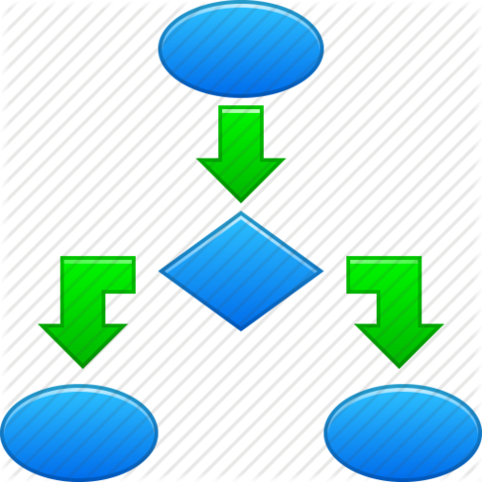

Databases 2
Algorithmic Data Science
Old notes

Slide 2
Overview
Basic database concepts
Relational databases
SQL
Interacting with SQL databases from Python
Limitations of relational approach
NoSQL
Interacting with NoSQL databases from Python
Cassandra / CQL

Slide 3
Relational databases and SQL
Structured Query Language.
Originally pronounced “Sequel”, now usually ``EssQueEll’’
Invented by the English computer scientist Edgar F. Codd whilst working at IBM in the 1970s
Dominant for many years and still incredibly popular / pervasive.
In a relational database management system the data is perceived by the user as tables (and nothing but tables).
Tables are referred to as relations
Each row or record is referred to as a tuple.
The number of tuples is referred to as the cardinality of the relation.
STUD# | SURNAME | COURSE# | DOB
S1 | Smith | C2 | 31/10/1982
S2 | Jones | C1 | 6/6/1995
S3 | Smith | C1 | 11/10/1990
COURSE# | NAME | SCHOOL#
C1 | Computer Science | SCH1
C2 | Artificial Intelligence | SCH1
Each column or field is referred to as an attribute. The number of attributes is referred to as the degree of the relation.

Slide 4
Limitations of Relational Approach
In the 1970s databases were conceived to store “operational data” for large enterprises (banks, universities, businesses, ....)
This data largely fit into the relational model – that the data should be perceived by the user as tables and nothing but tables.
The schema for such a database (i.e., how the database is divided into tables) could be designed once and then fixed.
Acceptable performance on cross-table joins and transactions could be achieved by hosting the database on a single, very large and powerful server.
Does this approach work for “big” data?

Slide 5
Big data database requirements
Support for massive volumes of data ... without placing it all on a single expensive server.
Support for variety in data forms:-
- Temporal data, spatial data, multimedia data, unstructured data, document libraries
Support for agility in database design – want to be able to quickly and cheaply integrate a new data source
Support for complex/structured data types, e.g. lists, dictionaries.
- Anything that doesn’t look like a (large) excel spreadsheet

Slide 6
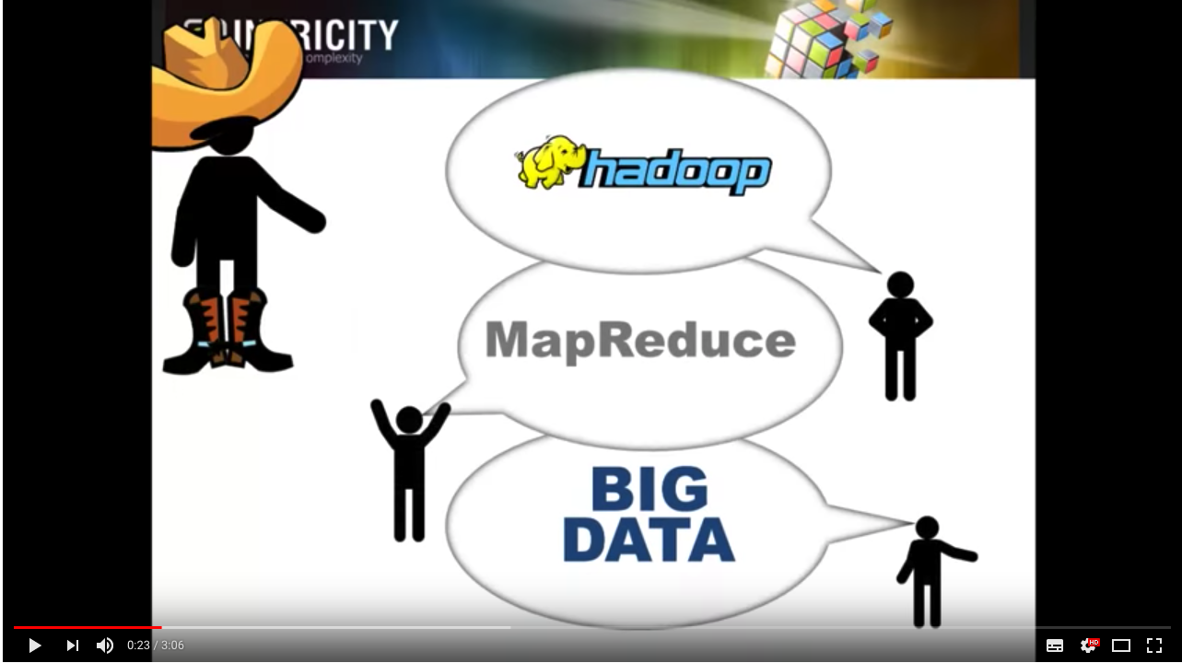
The Big Data Revolution- Rise and Fall of Hadoop
From overly structured relational databases -- that can’t write diverse and large data . . .
To overly unstructured data storage (Hadoop) -- that are difficult to read . . .
And on to semi-structured databases and NoSQL. . .
The arise of Hadoop (2012)
Notes:
https://www.youtube.com/watch?v=9s-vSeWej1U

Slide 7
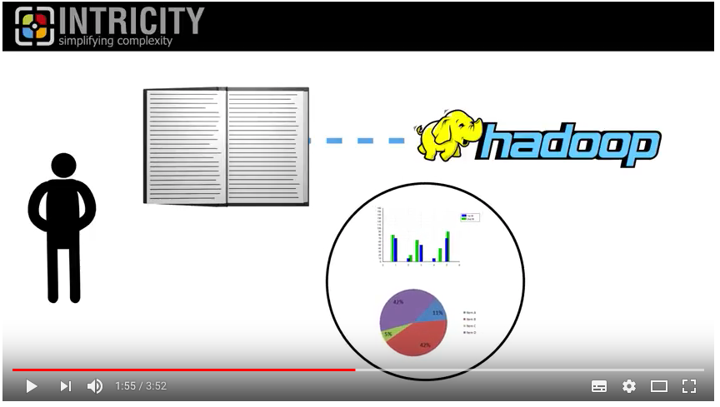
The Big Data Revolution
The Fall of Hadoop (2017)

Slide 8
NoSQL: Not Only Structured Query Language
The benefits of NoSQL databases are typically:
better handling of large volumes of rapidly changing structured, semi-structured and unstructured data
dynamic schemas which allow agile development
use of object-oriented programming paradigm
Horizontal scaling – increase capacity by adding more servers rather than increasing the size of a single server
Servers can be geographically distributed, i.e., in the cloud.
Databases can be automatically replicated to maintain availability in the event of localised outages or downtime.

Slide 9
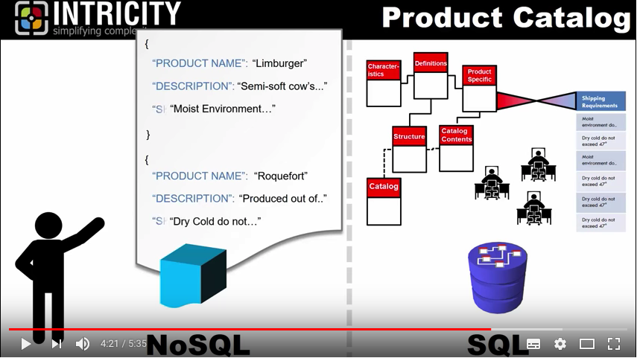
To be structured or unstructured
Somewhere between SQL and Hadoop: NoSQL (2015)

Slide 10
Types of NoSQL databases
Type | Description | Examples
Key-value stores | every single item in the database is stored as an attribute name (or key) together with its value | Berkeley DB Riak
Graph stores | used to store information about graphs/networks of data (e.g., social connections) | Neo4J Giraph
Document databases | pair each key with a complex data structure known as a document. Documents can contain many different key-value pairs, key-array pairs or nested documents. | MongoDB
Wide-column stores | optimised for queries over large datasets and store columns of data together, instead of rows. | Cassandra HBase

Slide 11
MongoDB
Uses a document data model
Each record and its associated data is thought of as a “document”
Documents encoded in a JSON-like format called BSON (essentially a binary encoding of JSON)
Advantages include
documents are independent units, related data is stored contiguously, making it easier to distribute data across multiple servers and maintain performance
application logic is written in any language which supports object-oriented programming. The object model in your application can be turned directly into a document.
Unstructured data is stored easily
Database does not need to know the schema in advance
Can query via secondary (or any nested) indices.
Notes:
Barclays HSBC

Slide 12
Installing and running the Mongo Shell
See here for installation instructions
Download mongodb (either using homebrew or manually)
Create a data directory – something like /data/mongodb
In a terminal, change to the directory where these binaries are stored (or put this directory in your system PATH variable)
At the terminal prompt, run a MongoDB instance by typing
./mongod –dbpath <path to data directory>
Open a second terminal window, change to the directory where the mongoDB binaries are stored and run the mongo shell by typing
Arguments can be added to connect to a mongoDB server process running on a different host using –host <hostname>
./mongo

Slide 13
Mongo Shell
We will mainly be interacting with the MongoDB via Python BUT there are some useful shell commands which I will list here.
Mongo shell command | description
help | Gives a list of available commands and their descriptions
use <db_name> | Use a particular database
use admin | Switch to the administrative database
db.shutdownServer() | Run this against the admin database in order to clean up all database resources and terminate the server process
exit | Exit the mongo shell

Slide 14
PyMongo
Setting up a connection and accessing a particular collection within a given database
import pymongo
from pymongo import MongoClient
client = MongoClient(host_name,port)
db=client.database_name
collection = db.collection_name
collection.find_one({key1:value1,key2:value2,…})
collection.find({key1:value1,key2:value2,…}
collection.insert_one({key1:value1,key2:value2,…})
collection.insert_many([{key1:valueA1,key2:valueA2,...},
{key1:valueB1,key2:valueB2,...}])
Finding the first or all documents which match a query specified by a dictionary
Inserting one or many new documents, all specified as dictionaries / json (values may be structured)
See the tutorial.

Slide 15
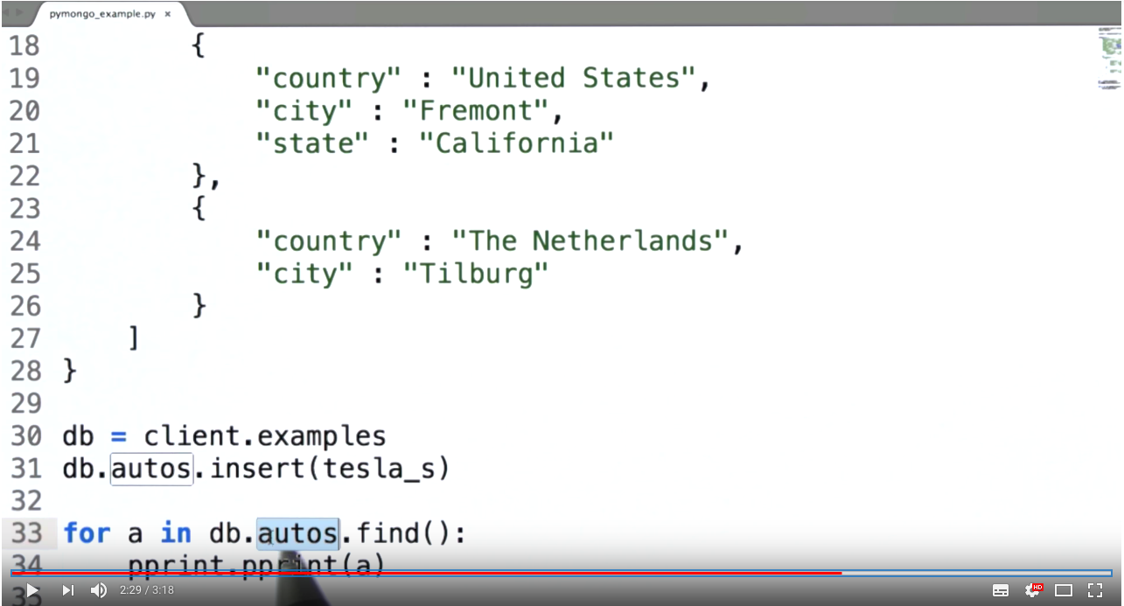
PyMongo Demo
Pymongo- Data Wrangling with MongoDB (3mins)
Pymongo- Building your first application: an introduction to MongoDB (15mins)

Slide 16
Column-oriented DBMS
Data tables stored as columns rather than rows
Practical use is very similar to a row-oriented DBMS
Can use SQL to interact with data
Row-oriented systems perform well at row-based queries – e.g., returning all information about a particular object
Column-oriented systems perform well at column-based queries – e.g., find all record with a particular attribute value
001:10, Smith, Joe, 40000
002:12, Jones, Mary, 50000
003:11, Johnson, Cathy, 44000
004:22, Jones, Bob, 55000
10:001; 12:002; 11:003; 22:004;
Smith:001; Jones:002,004; Johnson: 003;
Joe:001; Mary: 002; Cathy: 003; Bob: 004;
40000:001; 50000:002; 44000:004; 55000: 004
Notes:
Apache kudu

Slide 17
Cassandra
Hybrid between key-value and column-oriented DBMS
Uses Cassandra Query Language (CQL) as an alternative to SQL
Developed by Facebook and released as open-source project in 2008
Main features:
Data is distributed across a cluster (no single point of failure)
Supports replication, fault-tolerant
Horizontal scaling
Tunable consistency
Hadoop integration with MapReduce support (+Apache Pig and Apache Hive)
Notes:
discord

Slide 18
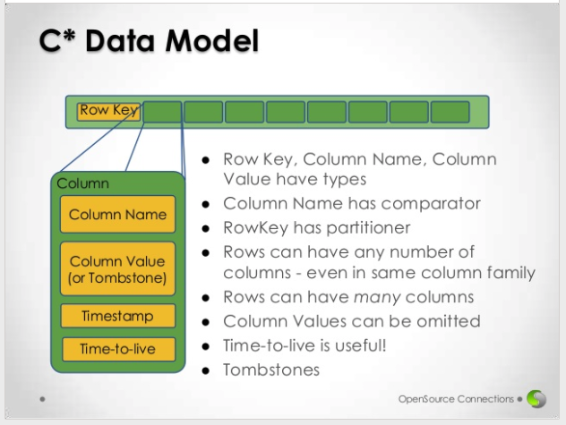
Cassandra’s Data Model
Automatic delete after specified time
Null values, deletes etc
Notes:
More traditional, limited support for querying secondary indices.

Slide 19
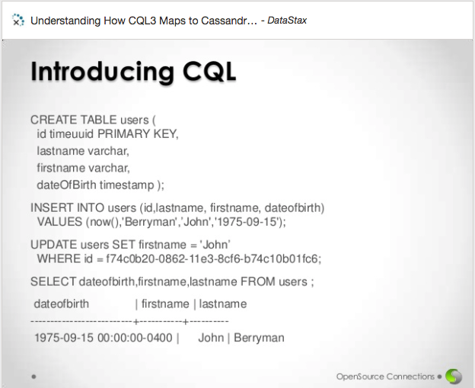
CQL is just like SQL ….

Slide 20
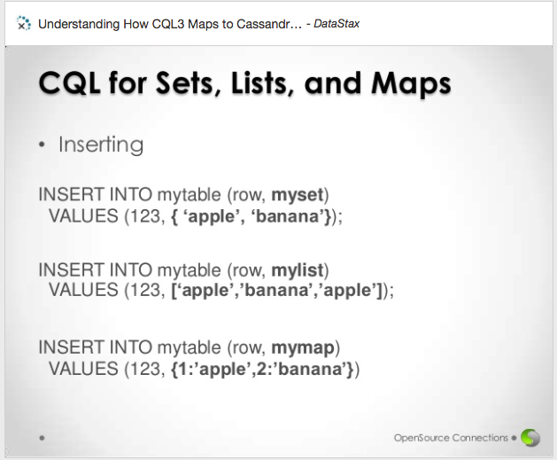
But there’s more to CQL than SQL
Notes:
https://www.simplilearn.com/cassandra-vs-mongodb-article

Slide 21
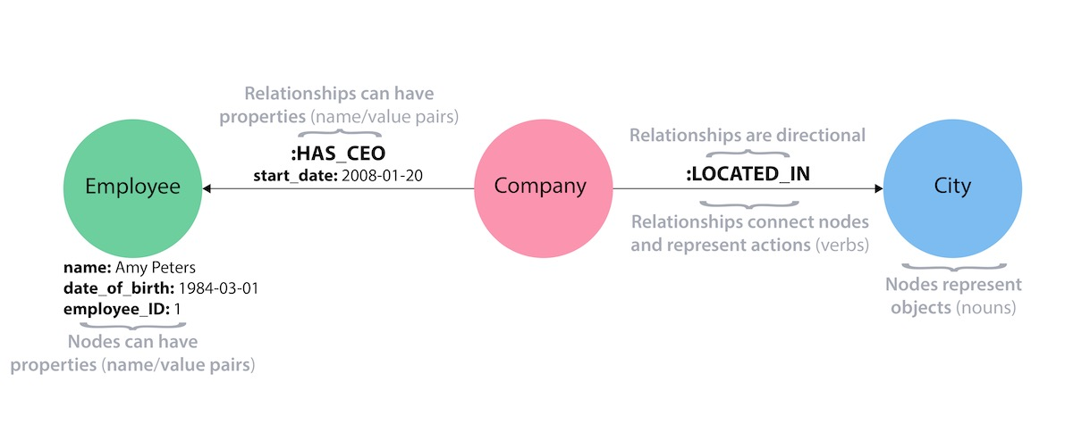
Graph databases: Neo4j
https://neo4j.com/developer/graph-database/
Fast relationship-based queries: e.g. “Which supplier provided the products owned by this group of customers?”
But might be slower than a relational database for something simple like "Who were all the customers with income over $100K between the ages of 35 and 50?".
Notes:
Do you want to span the entire database?

Slide 22
Summary
Basic database concepts
Relational databases
SQL
Interacting with SQL databases from Python
Limitations of relational approach
NoSQL
Interacting with NoSQL databases from Python
Cassandra / CQL
Graph databases
Notes:
Easy read vs easy write.

